Slide 1

SRI VENKATESWARA COLLEGE OF ENGINEERING & TECHNOLOGY (An Autonomous Institution) DEPARTMENT OF COMPUTER SCIENCE AND ENGINEERING (AI&ML) (Affiliated to JNTUA, Anantapur, Approved by AICTE, New Delhi, Accredited by NBA,
New Delhi & NAAC with A+ Grade, Bangalore.
An ISO 9001-2000 Certified Institution), R.V.S NAGAR, CHITTOOR-517127
APRIL 2024

Slide 2
ADVANCED ALGORITHMS IN STOCK MARKET PRICE FORECASTING BATCH-07 CSM

Slide 3
OUTLINE:
Abstract
Introduction
Problem Statement
Literature Survey
Block Diagram
Output
Conclusion

Slide 4
Team:
M. Charan (20781A3332)
A. Jaya Sankar (20781A3301)
A. Pavankumar (20781A3302)
B. Chaitanya prasad (20781A3309)
C. Reddy Sekhar (20781A3313)

Slide 5
Abstract
Stock market prediction is one of the most difficult tasks in the field of accounting.
There are many factors involved in forecasting - physical factors against behavior, rational and irrational, investor sentiments, market rumors. All these factors include making stock prices more flexible and making it more difficult to predict with a high degree of accuracy.
We are investigating data analysis as a game changer for this domain.
As with effective market theory where all company-related information and stock market events are readily available to all market participants / investors, then the results of those events are already embedded in the stock price. Therefore, it is said that only the price of a historical site holds the impact of all other market events and can be hired to predict its future movement.
Therefore, we consider past stock prices as the final expression of all influential factors using Machine Learning (ML) techniques in historic and details that we have not seen before, and these can be used to make accurate predictions. We propose a framework that uses the LSTM (Long-Term

Slide 6
Introduction
Data analysis have been used in all business for data-driven decision making. In share market, there are many factors that drive the share price, and the pattern of the change of price is not regular. This is why it is tough to take a robust decision on future price.
Artificial Neural Network (ANN) has the capability to learn from the past data and make the decision over future. Deep learning networks such as Convolutional Neural Network (CNN), Recurrent Neural Network (RNN) etc. works great with multivariate time series data.
We train our model from the past stock data and calculate the future price of that stock. This future price use to calculate the future growth of a company.
Moreover, we found a future growth curve from different companies. Thus, we can analyze and investigate the similarity of one company’s future curve over another. Stock price of a listed company in a stock exchange varies every time an order is placed for sell or buy and a transaction completes.
An exchange collects all sell bids with expected price per stock (normally it is more than the price paid while bought by the investor) and all buy bids with or without a price limit (normally an investor expects the future price of the stock will be more than the current price he is paying now)

Slide 7
Introduction
And a buy- sell transaction is committed when both bids have a match i.e. selling bid price is same with buying bid price of some buy-bid Fama in 1970 [1] proposed efficient market hypothesis which says that in an efficient market (where all events are known to all stakeholders as an when it happens).
The effect all market events are already incorporated in stock prices hence it is not possible to predict using past events or prices.
The stock price of a company depends on many intrinsic as well as extrinsic attributes. Macro-economic conditions too play an important role in growth or decline of a sector as a whole.
Some of the intrinsic factors could be company’s net profit, liabilities, demand stability, competition in market, technically advanced assembly line, surplus cash for adverse situations, stakes in raw material supplier and finished product distributors etc. Those factors that are beyond the control of the company such as crude oil price,

Slide 8
Introduction
dollar exchange rate, political stability, government policy decision etc. come under extrinsic attribute. Many researchers have tried using the historical stock prices as the basis for time series analysis to forecast future stock prices.
Many different statistical models were applied since long like moving average (MA), auto regression (AR), weighted moving average, ARIMA, CARIMA etc. Later some non linear models were also tried like GARCH. Recently different neural network models, evolutionary algorithms were being applied for stock prediction with success.
Deep neural networks like CNN, RNN are also used with different parameter settings and features. In this paper we shall explore a special type of RNN known as LSTM to predict future company growth based on past stock prices.

Slide 9
Problem Statement
The stock market appears in the news every day. You hear about it every time it reaches a new high or a new low.
The rate of investment and business opportunities in the Stock market can increase if an efficient algorithm could be devised to predict the short-term price of an individual stock.
Previous methods of stock predictions involve the use of Artificial Neural Networks and Convolution Neural Networks which has an error loss at an average of 20%.
In this report, we will see if there is a possibility of devising a model using Recurrent Neural Network which will predict stock price with a less percentage of error. And if the answer turns to be YES, we will also see how reliable and efficient this model will be.

Slide 10
Proposed System
The proposed system aims to develop a robust framework for stock market analysis and prediction using artificial neural networks (ANN), specifically leveraging deep learning techniques such as Convolutional Neural Networks (CNN) and Recurrent Neural Networks (RNN).
The system will integrate real-time market data and historical stock prices to train predictive models capable of forecasting future price movements and identifying trends in the market.

Slide 11
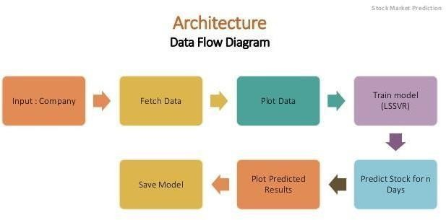

Slide 12
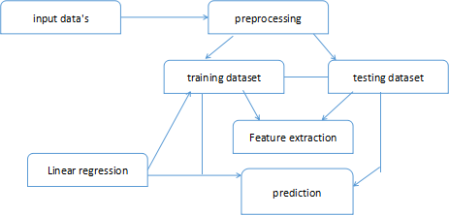

Slide 13
Literature Survey
Stock price prediction can be predicted using AI and machine learning models in machine learning fields. Using the SVM model for stock price prediction. SVM is one of the machine learning algorithms which works on classification algorithms. It is used to get a new text as an output.
Applying Multiple Linear Regression with Interactions to predict the trend in stock prices which is used
to predict stock prices, said that the stock values are changes random and the past price values are not
dependent on current values. EMH is different from the Random walk hypothesis but the EMH works
mainly on Short term
patterns for predicting stock prices. Manh Ha Duong Boris's Siliverstovs, search the abstraction between equity prices and combined finances in Key Eu nations like UK and Germany. Acceleration in Eu nations investments is apt to results successful even Stronger correlation between the different Eu nations and equity prices.
This operation may also lead to a merge in financial development between EU nations, if advancements in stock markets affect real financial instruments, such as investing and Consuming.

Slide 14
Literature Survey
LSTM algorithm consists of a Recurrent Neural network to encode data. The algorithm inputs are economic news headings infusion From Bloomberg and Reuters.
Long Short- term Memory with embedded layer and the LSTM with the automatic encoder in the stock market for predicting stock values. The Xiongwen Pang et al.
Correlation coefficients in stocks are selected randomly and predicted using ARIMA and the neural network approach.
In this RNN and LSTM algorithms are implemented. Recently, Pranab Bhat, 2020 used convolution neural networks for predicting stock values, in this model learning is finished by computing the mean square blunder for each consequent perception and a model is picked that has the
least mistake and high prescient power.
In this paper, they are utilizing CNN for anticipating stocks and incentives for the following day. Mohammad Mekayel Anik et al, 2020, implemented a linear regression algorithm for future stock price prediction.

Slide 15
Hardware Requirements
Server:
Processor: Intel Xeon or AMD Ryzen server-grade processor with multiple cores for parallel processing.
RAM: Minimum 32 GB ECC RAM for handling large datasets and model training.
Storage: SSD storage with at least 1 TB capacity for storing historical data and model parameters.
GPU (Optional): NVIDIA Tesla or AMD Radeon Instinct GPU for accelerating deep learning computations.
Network Interface: Gigabit Ethernet adapter for fast data transfer between servers and client devices.
Client Devices:
Desktop/Laptop: Minimum 8 GB RAM, modern CPU (Intel Core i7 or equivalent) for accessing web-based applications and data visualization tools.
Mobile Devices: Compatible with Android and iOS devices, with modern web browser support for accessing the system remotely.

Slide 16
Software Requirements
Operating System:
Server: Linux-based server operating system (e.g., Ubuntu Server) for stability, security, and compatibility with deep learning frameworks.
Client Devices: Compatible with various operating systems including Windows, macOS, Linux, Android, and iOS.
Deep Learning Frameworks:
Tensor Flow: Open-source deep learning framework developed by Google for building and training neural network models.
PyTorch: Deep learning framework maintained by Facebook's AI Research lab, known for its dynamic computation graph and ease of use.
Keras: High-level neural networks API built on top of TensorFlow and Theano, providing a user-friendly interface for building and training models.
Development Tools:
Python: Programming language used for developing machine learning algorithms, data processing, and system integration.

Slide 17
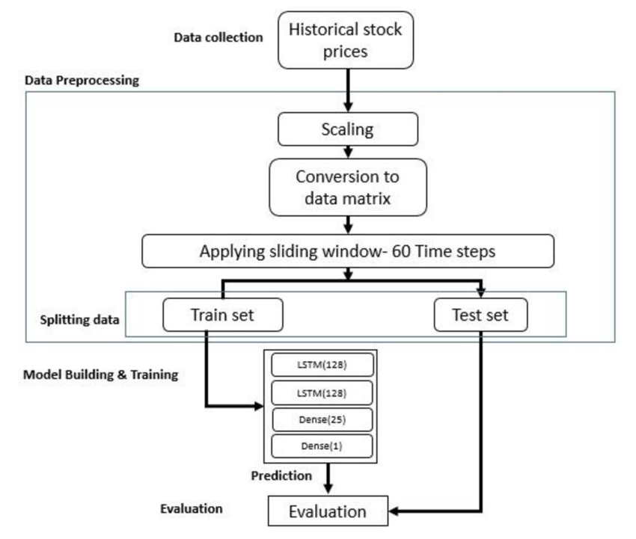
Block Diagram

Slide 18
Block Diagram
Pre-processing of data: In pre-processing, we are selecting attributes required for the algorithm and the remaining attributes are neglected.
The selected attributes are Trade Open, Trade High, Trade Low, Trade Close, Trade Volume.
In pre-processing, we are using normalization to get values in a particular range.
Prediction using LSTM: In this system, we are using the LSTM algorithm for predicting stock values. Initially, the training data is passed through the system and train the model.
Then in the testing phase, the predicted values are compared with the actual values. Evaluation: In the evaluation phase we are calculating the Accuracy, Mean Square Error(MSE) and Root Mean Square Error (RMSE) values for comparison.

Slide 19
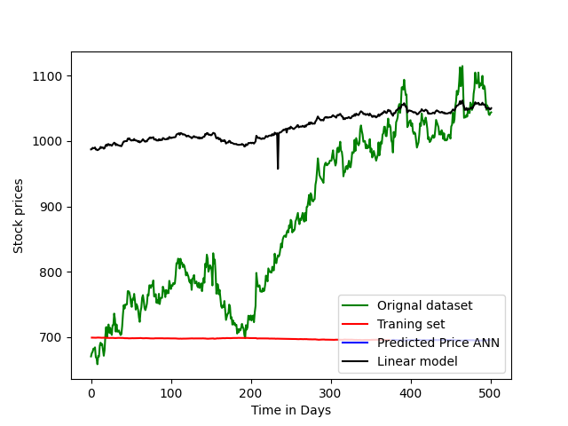
Screen Shot

Slide 20
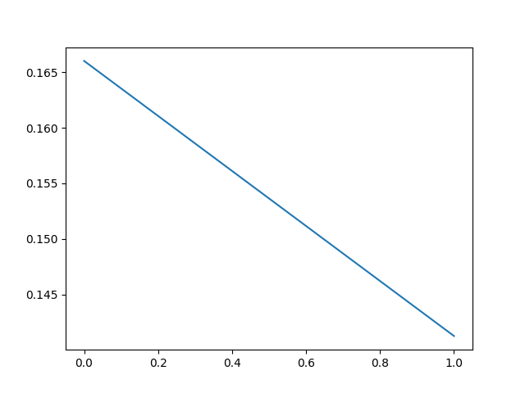
Screen Shot

Slide 21
Conclusion
In this paper, we analyze the growth of companies in different sectors and try to find out what is the best time to predict the future price of the stock.
Therefore, it is an important conclusion that companies in a particular sector have the same dependency as well as the same growth rate. The prediction may be more accurate if the model trains with many data sets.
Moreover, in the case of different stock forecasts, there may be little scope for specific business analysis. We can study different patterns of stock prices in different regions and analyze graphs with more different time periods to better tune the accuracy.
This framework helps extensively in market analysis and forecasting the growth of different companies over different time periods. Incorporating other parameters (e.g. investor sentiment, election results, geopolitical stability) that are not directly related to the closing price may improve the accuracy of the forecast.

Slide 22
Reference
[1] Stock Price Prediction Using LSTM on Indian Share Market by Achyut Ghosh, Soumik Bose1, GiridharMaji, Narayan C. Debnath, Soumya Sen
[2] S. Selvin, R. Vinayakumar, E. A. Gopalkrishnan, V. K. Menon and K. P. Soman - Stock price predictionusing LSTM, RNN and CNN-sliding window model - 2017.
[3] Murtaza Roondiwala, Harshal Patel, Shraddha Varma, “Predicting Stock Prices Using LSTM” in Undergraduate Engineering Students, Department of Information Technology, Mumbai University, 2015.
[4] Xiongwen Pang, Yanqiang Zhou, Pan Wang, Weiwei Lin, “An innovative neural network approach for stock market prediction”, 2018
[5] Ishita Parmar, Navanshu Agarwal, Sheirsh Saxena, Ridam Arora, Shikhin Gupta, Himanshu Dhiman, Lokesh Chouhan Department of Computer Science and Engineering National Institute of Technology, Hamirpur – 177005, INDIA - Stock Market Prediction Using Machine Learning.

Slide 23
Thank You

